Slide 1
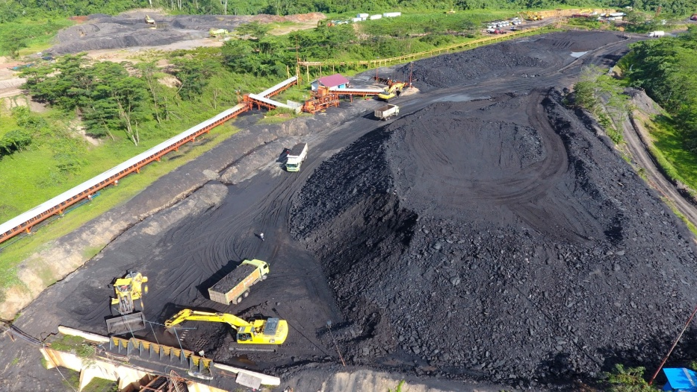

PT Resource Alam Indonesia Tbk
Presented on the 3rd of April 2017
IDX: KKGI Bloomberg: KKGI.IJ Reuters: KKGI.JK

Slide 2
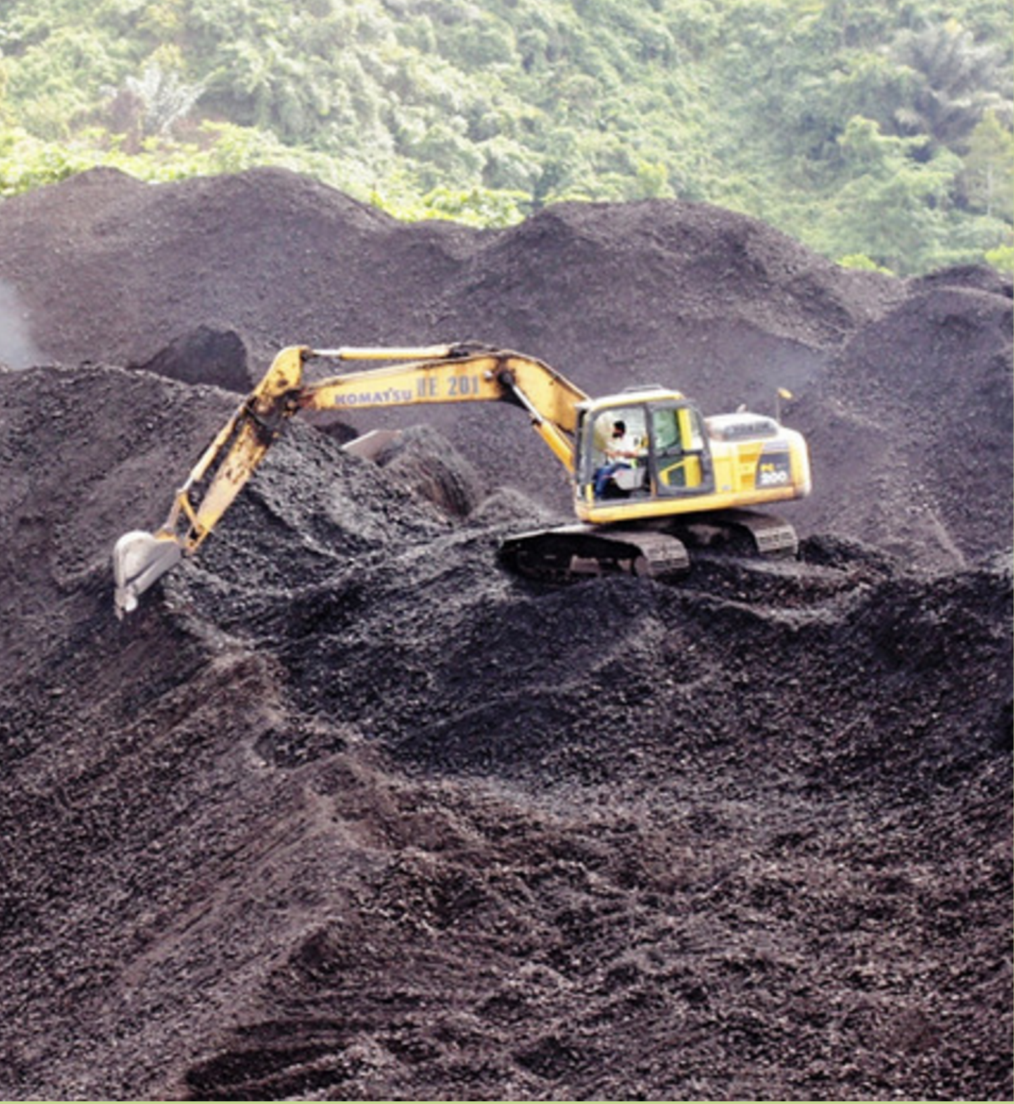
Our History
1981: KKGI was established as Kurnia Kapuas Utama Glue Industries.
1991: KKGI held its IPO.
1997: Acquired PT. Insani Baraperkasa - a 3rd Generation CCoW coal concession.
2004: Changed name to PT. Resource Alam
Indonesia Tbk.
2006: Production begins at PT. Insani Bara
Perkasa.
2012: KKGI wins Best of the Best award under $1 billion from Forbes Asia.
2013: KKGI acquires PT. Loa Haur and
PT. Kaltim Mineral.
2016: PT. Kalimantan Prima Persada (KPP)
begins work as subcontractor at PT. Insani's
Loa Janan block.
Notes:
CHANGE PICTURE TO ONE WITH COAL

Slide 3
Ownership Structure
As of December 31, 2016
31.4 %
25.5 %
8.0 %
32.0 %
Energy Colliers
Pte Ltd
Goodwin
Investment Prvt
Ltd
UBS AG
Public *
PT RESOURCE ALAM INDONESIA TBK (KKGI)
PT Insani Baraperkasa
PT Kaltim Mineral
PT Loa Haur
PT Khatulistiwa Hidro Energi
99.9 %
75.0 %
60.0 %
43.0 %

Slide 4
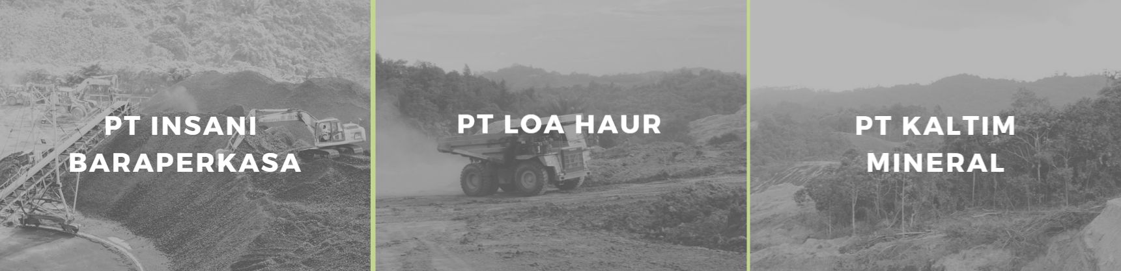
Mine Concessions
3rd Generation CCoW in East Kalimantan
Concession Area: 24,477 Ha
69.82 million MT of proven coal reserves
In Production
IUP Production in Central Kalimantan
Concession Area: 5,000 Ha
12 million MT of proven coal reserves
(4650 – 6191 GAR)
To begin production
Late 2017
IUP Exploration in East Kalimantan
Concession Area: 10,000 Ha
60 million MT of coal resources
34 million MT of proven coal reserves

Slide 5
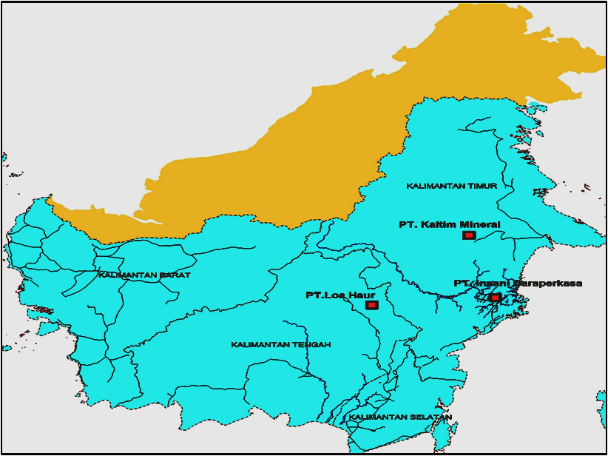
Mine Concessions

Slide 6
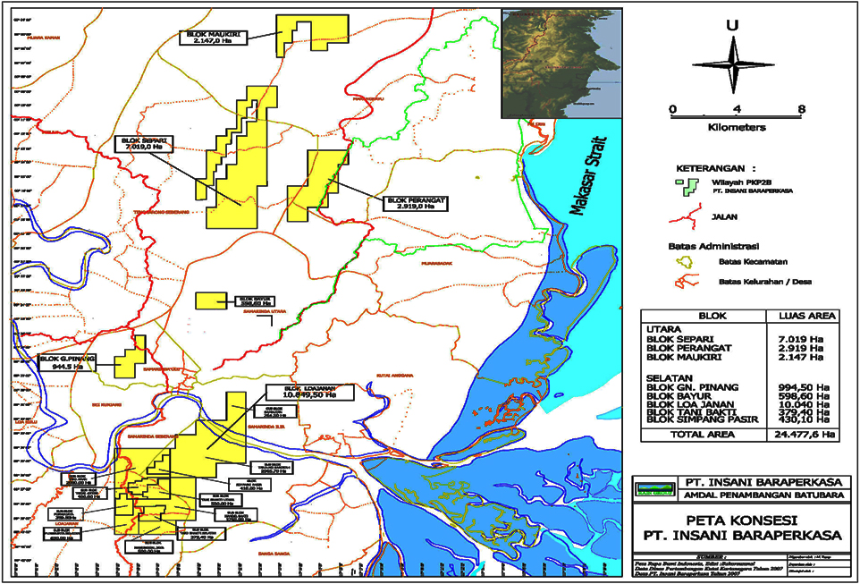
PT. Insani Bara Perkasa
Strategic location close to Kota Samarinda and 12 km from pit to port
Notes:
Confirm location of our mine mouth area and the 3800+ GAR coal location. Put article from the Jakarta post at the end (after the Thank You)

Slide 7
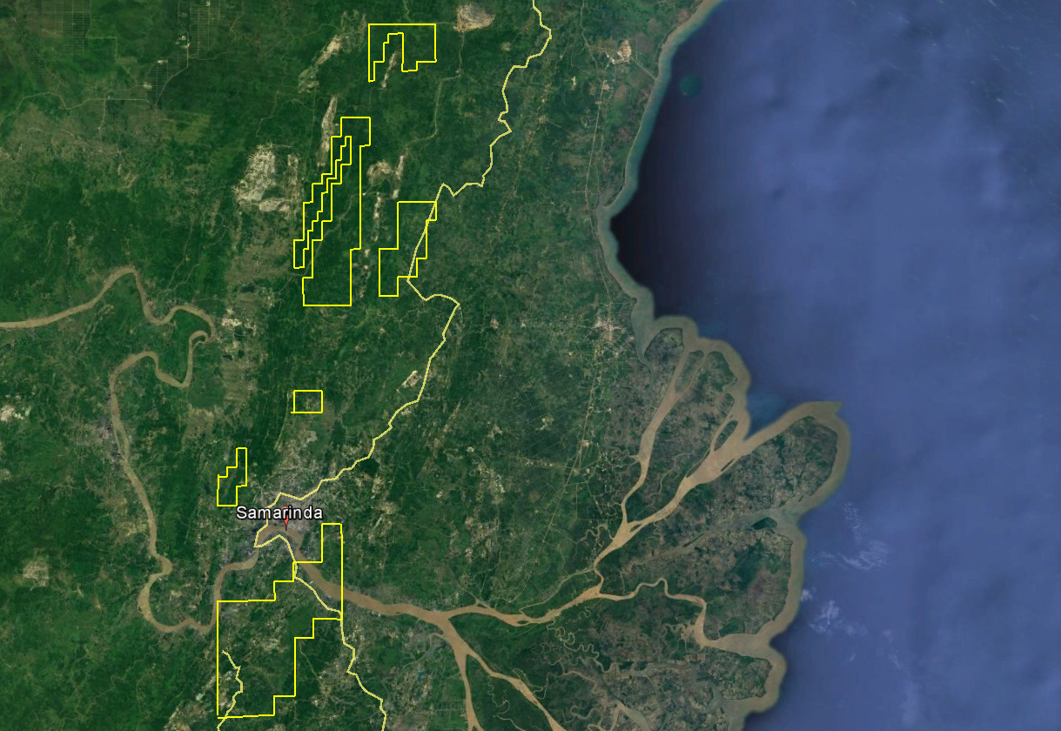
PT. Insani Bara Perkasa – Satellite View
Strategic location close to Kota Samarinda and 12 km from pit to port
Notes:
Satellite 2

Slide 8
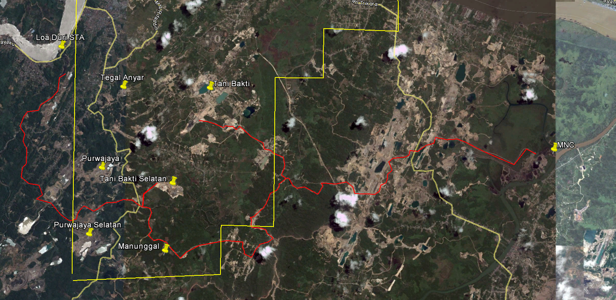
PT. Insani Bara Perkasa – Southern Block Pits
Strategic location close to Kota Samarinda and 12 km from pit to port
Notes:
Satellite 1

Slide 9
PT. Insani Bara Perkasa – In a Nutshell
One of the Largest CCoW Concession in Indonesia with concession area of 24,477 Ha. Largely untapped with current mining area of 2,000 Ha.
Concession Life until 2036 with option to renew for 10 years, twice.
All pits in production are favourably positioned a current average of 12 km from the nearest port.
Average stripping ratio of 6 with plans to increase by 1 or 2 SRs.
Calorific values between GAR 3800 to GAR 5800.
Newly appointed contractor, PT. Kalimantan Prima Persada, is a subsidiary of United Tractors with good reputation and track record.

Slide 10
PT. Insani Bara Perkasa - Infrastructure Capacity
SITE/BLOCK AREA | DISTANCE (KM) | PORT | CRUSHER CAPACITY | LOADING CAPACITY
Purwajaya | 13 | Loa Duri | 1,000 MT/Hour | 1,200 MT/Hour
Purwajaya Selatan | 10
Manunggal Jaya | 19
Tani Bakti | 14
Handil Bakti | 22
Handil Bakti | 11 | PSM | 300 MT/Hour | 150 MT/Hour
Handil Bakti | 11 | MNCI | 750 MT/Hour | 1,000 MT/Hour
Tanibakti Utara | 15
Tani Bakti Utara | 17 | SBB | 500 MT/Hour | 500 MT/Hour
Separi | 22 | SHS | 350 MT/Hour | 500 MT/Hour
TOTAL/ Hour |  |  | 3,500 MT/Hour | 3,675 MT/Hour
TOTAL/ Year |  |  | 18,792,000 MT/Year | 21,708,000 MT/Year
 |  |  |  | * 1 year=360 day, 1 day=18 hour

Slide 11
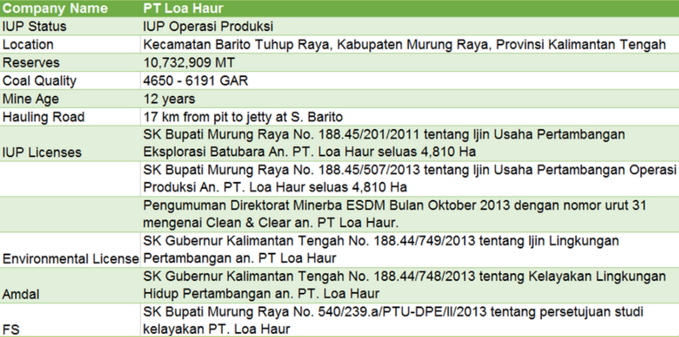
PT. Loa Haur Factsheet
Notes:
Possible to do 75k tons

Slide 12
KKGI Annual Production (‘000 MT)

Slide 13
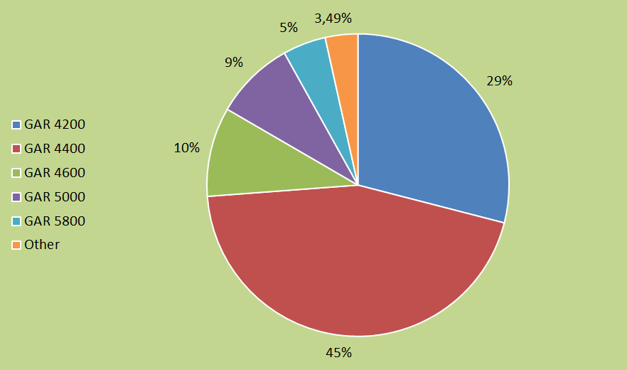
KKGI Sales by Calorific Value (FY2016)

Slide 14
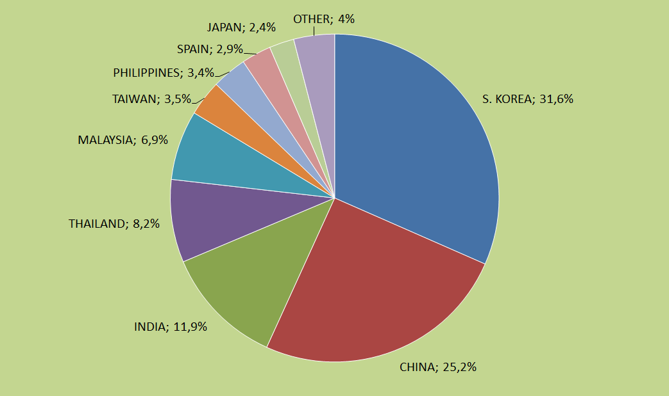
KKGI Sales by Destination (FY2016)
Notes:
Production Q4 16 is 540,142 MT

Slide 15
Quarterly Production and Sales
Notes:
Production Q4 16 is 540,142 MT

Slide 16
Indonesia Coal Index (January 2016 to February 2017)
Source: Argus/Coalindo ICI Reports. Prices listed are FOB Mother Vessel.
Notes:
Production Q4 16 is 540,142 MT

Slide 17
Quarterly Cash Cost and Average Selling Price
Notes:
Production Q4 16 is 540,142 MT

Slide 18
Financial Summary
 | Dec 2016 | Dec 2015 | Dec 2014
Total Asset | 98,706,750 | 98,541,575 | 106,215,088
Total Liabilities | 14,299,044 | 21,780,410 | 32,330,874
Equity | 84,409,706 | 76,761,165 | 73,884,214
 | 12M 2016 | 12M 2015 | 12M 2014
Net Revenue | 92,636,624 | 111,011,540 | 135,766,894
Gross Profit | 23,859,303 | 26,472,296 | 22,296,619
Operating Profit | 14,814,199 | 9,436,240 | 12,987,714
NPAT | 9,472,864 | 5,672,213 | 8,002,278
ROA | 9.60% | 5.76% | 7.50%
ROE | 11.22% | 7.39% | 10.80%
Gross Margin | 25.76% | 23.85% | 16.42%
Net Margin | 10.23% | 5.11% | 5.89%
Notes:
Production Q4 16 is 540,142 MT

Slide 19
Preview of KKGI in 2017
Targeting production of 4 million MT in 2017
PT. KPP in takeover process and preparing to increase production
Adding more contractors in Handil Bakti and other areas
Introduction of blasting and larger machinery in Southern Blocks
Ramping up Production of GAR 5200 – 5800 coal in northern Separi block
Plans to begin production at PT. Loa Haur in Q4 2017
Notes:
Production Q4 16 is 540,142 MT

Slide 20
Going Forward
STEADFASTLY increase good corporate governance
FOCUS on increasing production and operational efficiency
EXPAND current production areas through exploration efforts
MAXIMIZE returns for our shareholders
MAINTAIN best mining practices, environmental management, and community development programs
Notes:
Production Q4 16 is 540,142 MT

Slide 21
FY 2017 Revenue Projection
3.6 million MT Projection
Item | Unit | Value
Average Selling Price (GAR 4400) | USD | 40.00
Royalty |  | 13.50%
ASP Net of Royalty | USD | 34.60
Total Cost | USD | 23.00
Gross Profit per Ton | USD | 11.60
Corporate Tax Rate |  | 30%
Net Profit per Ton | USD | 8.12
Total Tons Produced | MT | 3,600,000
Net Profit | USD | 29,232,000
 | IDR | 394.6 B
# of Shares |  | 5 B
EPS | IDR | 78.93
4 million MT Projection
Item | Unit | Value
Average Selling Price (GAR 4400) | USD | 40.00
Royalty |  | 13.50%
ASP Net of Royalty | USD | 34.60
Total Cost | USD | 23.00
Gross Profit per Ton | USD | 11.60
Corporate Tax Rate |  | 30%
Net Profit per Ton | USD | 8.12
Total Tons Produced | MT | 4,000,000
Net Profit | USD | 32,480,000
 | IDR | 438.48 B
# of Shares |  | 5 B
EPS | IDR | 87.70
Notes:
Production Q4 16 is 540,142 MT

Slide 22
Disclaimer
These materials have been prepared by PT Resource Alam Indonesia Tbk (the “Company”) and have not been independently verified. No representation or warranty, expressed or implied, is made and no reliance should be placed on the accuracy,
fairness or completeness of the information presented or contained in these materials.
The Company or any of its affiliates, advisers or representatives accepts no liability whatsoever for any loss howsoever arising from any information presented or contained in these materials. The information presented or contained in these materials is subject to change without notice and its accuracy is not guaranteed.
These materials contain statements that constitute forward-looking statements. These statements include descriptions regarding the intent, belief or current expectations of the Company or its officers with respect to the consolidated results of operations and financial condition of the Company. These statements can be recognized by the use of words such as “expects,” “plan,” “will,” “estimates,” “projects,” “intends,” or words of similar meaning. Such forward looking statements are not guarantees of future performance and involve risks and uncertainties, and
actual results may differ from those in the forward-looking statements as a result of various factors and assumptions.
The Company has no obligation and does not undertake to revise forward-looking statements to reflect future events or
circumstances.
These materials are for information purposes only and do not constitute or form part of an offer, solicitation or invitation of any offer to buy or subscribe for any securities of the Company, in any jurisdiction, nor should it or any part of it form the basis of, or be relied upon in any connection with, any contract, commitment or investment decision whatsoever. Any decision to
purchase or subscribe for any securities of the Company should be made after seeking appropriate professional advice.

